Slide 1
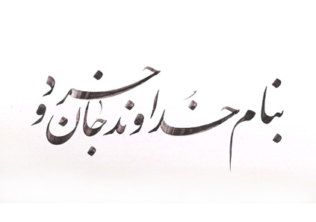

Slide 2
The Attitude of Medical Students Toward Complementary Medicine:
Results of a Cross-Sectional Study
Mahdie Hajimonfared, MD-PhD of Persian Medicine
Research Center for Traditional Medicine and History of Medicine, Shiraz University of Medical Sciences

Slide 3
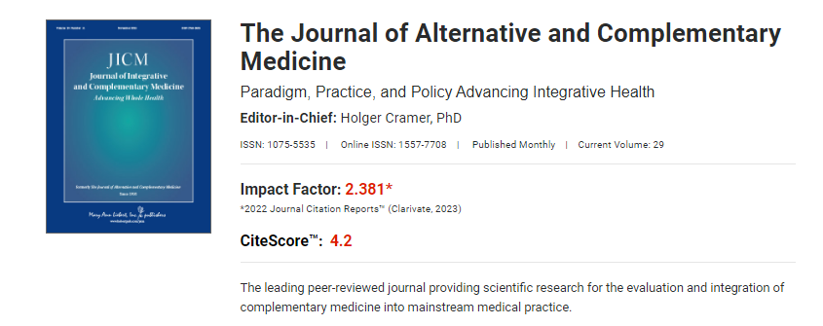
About Journal:

Slide 4
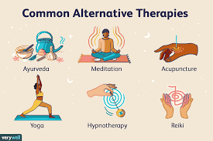
Introduction
Complementary medicine (CM) covers a heterogeneous group of diagnostic and therapeutic procedures that are not part of but can be used in combination with conventional medicine.

Slide 5

Question?
What percentage of people in the world do you think
use complementary medicine?

Slide 6
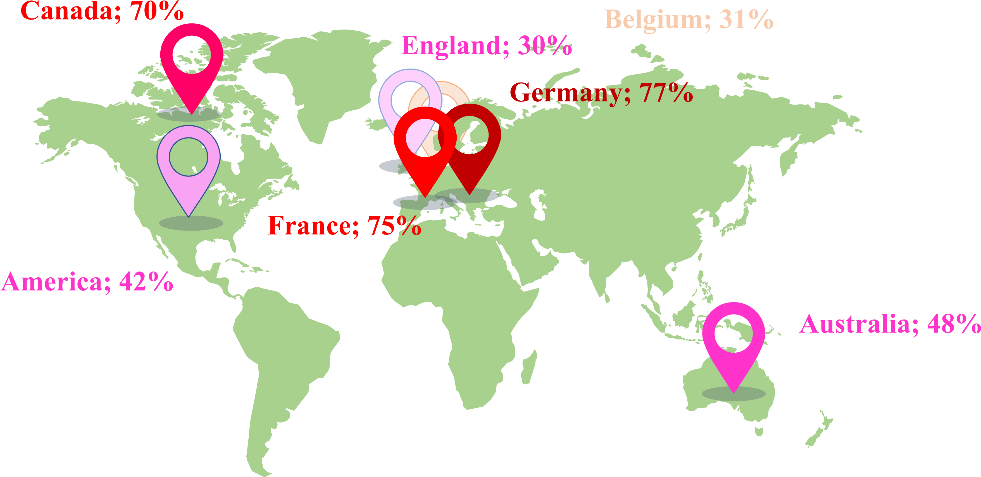
Introduction
European CM use ranges from up to 86%.
In Germany, more than 60%–85% of physicians offer
CM or refer to it.

Slide 7
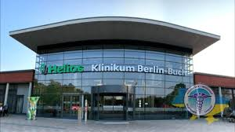
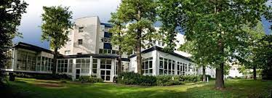
Visiting complementary medicine clinics in Germany
https://www.placidway.com/profile/322984/Center-for-Advanced-Medicine-for-Chronic-and-Rare-Disease
httpbookinghealth.com/programs/treatment/alternative-medicine/0/germanys://

Slide 8
Methods
Study design and setting:
cross-sectional study
among medical students(349 students) in the first year and the fifth year
Charite´—Universita¨tsmedizin Berlin

Slide 9
Methods
Study design and setting:
1-10-item CHBQ (Complementary and Alternative Medicine Health Belief Questionnaire):
CM in university: CM should be scientifically researched at the University, CM should be integrated into university teaching, CM is satisfactorily taught at the university
CM self-studies
CM in future career: Acupuncture, Osteopathy, Homeopathy, Naturopathy

Slide 10
Methods
Study design and setting:
2-Students’ Own Complementary Medicine Use During Their Lifetime and the Last 12 Months
Acupuncture, Acupressure, Tai Chi/qigong, Osteopathy, Chiropractic, Manual therapy, Homeopathy, Ayurveda

Slide 11
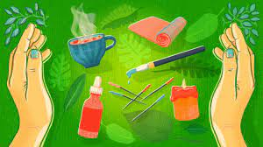
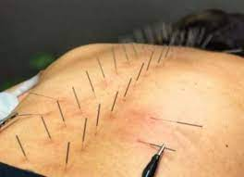
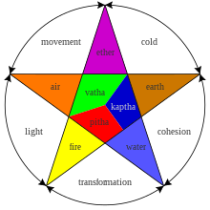
Types of complementary medicine
How much do you know???????

Slide 12
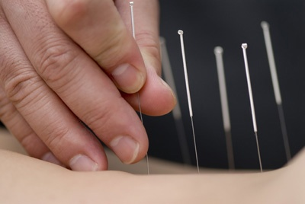
Acupuncture
Acupuncture is a traditional Chinese medicine that some people use to manage a variety of conditions
Practiced in China for over 4,000 years

Slide 13
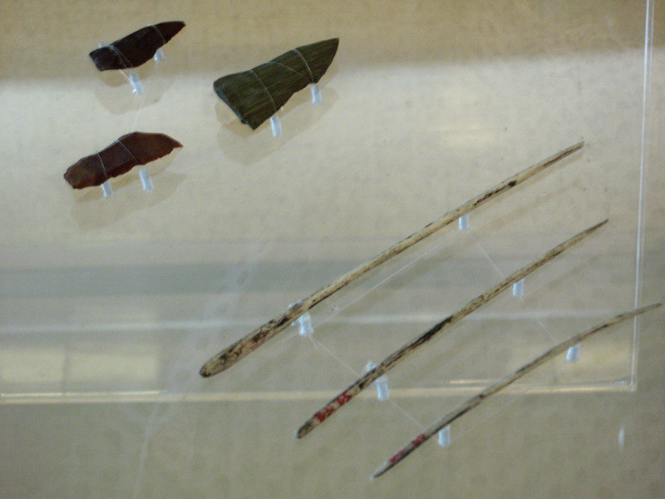
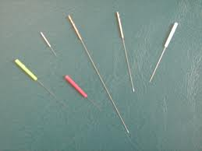
Acupuncture
Stone age bone needles
Modern Needles

Slide 14
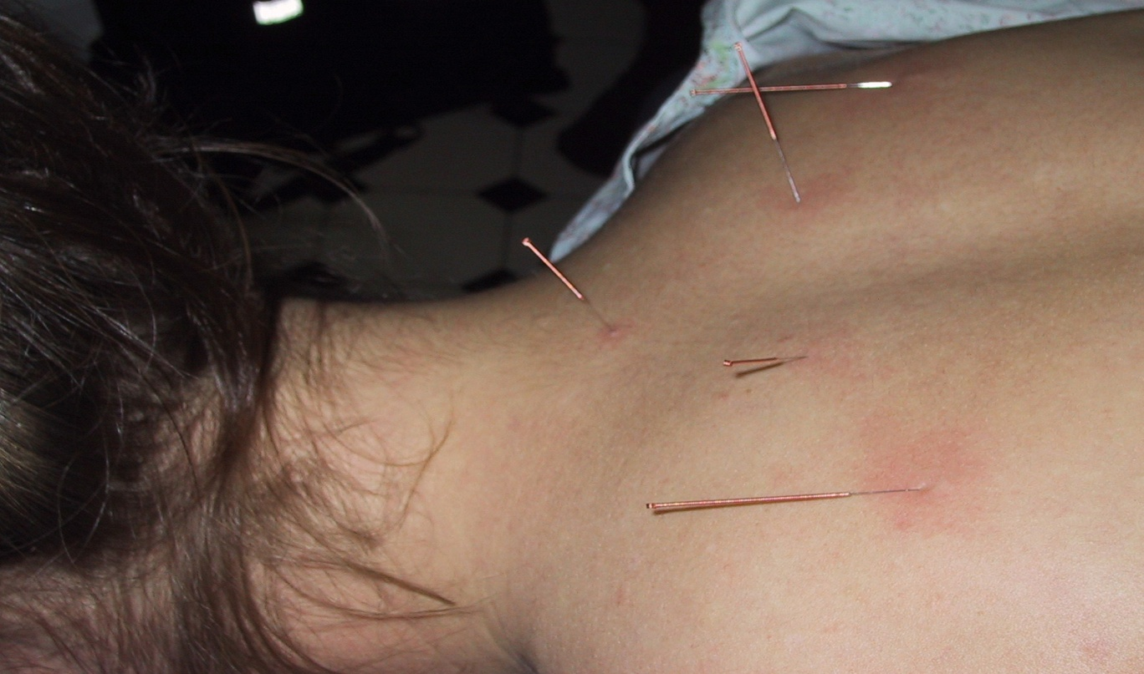
Acupuncture
Acupuncture is the insertion of needles in specific points on the body
These insertion points are believed to correspond with 14 main pathways within the body called meridians

Slide 15
What is acupuncture used to treat?
Depression Paralysis
Hypertension
Tendonitis
Vision problems
Sexual Dysfunction
Migraines
Arthritis
Kidney problems
Flu
Fatigue
Chronic pain
And many others

Slide 16
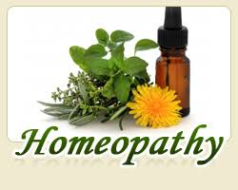
Homeopathy
Homeopathy is an alternative medicine based on the theory of treating 'like with like'.
It was conceived in 1796 by the German physician Samuel Hahnemann

Slide 17
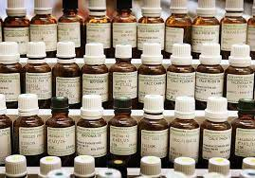
Homeopathy
Homeopathic medicines are made from a variety of sources, such as plants, animals and minerals.
Homeopathic medicines are considered safe and free from serious adverse reactions.

Slide 18
Homeopathy
To determine a treatment plan for a person, a homeopath will consider all of the person’s symptoms (physical, mental or emotional) and identify the remedy that is capable of producing in a healthy person, symptoms most ‘like’ the symptoms the person is suffering from.
Homeopathic medicines can be in the form of liquid, granules, powder or tablets.

Slide 19
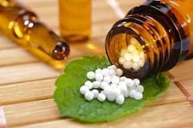
Homeopathy
The preparation of homoeopathic medicines :
repeated dilution and shaking called ‘potentisation’
stimulating the body’s natural healing forces
After the 12th dilution, there is no discernible chemical trace
but homeopaths believe the preparation retains the qualities of the original substance.

Slide 20
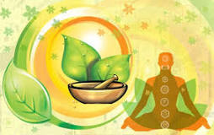
Ayurveda
a natural system of medicine, originated in India more than 3,000 years ago
Ayurveda translates to knowledge of life

Slide 21
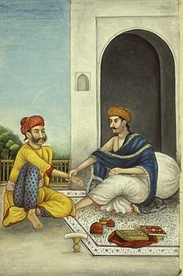
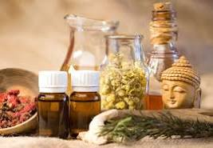
Ayurveda
It’s based on the belief that health and wellness depend on a delicate balance between the mind, body, and spirit.
Its main goal is to promote good health, not fight disease.
But treatments may be geared toward specific health problems.

Slide 22
Ayurveda
Those who practice Ayurveda believe every person is made of five basic elements found in the universe:
Space
air
fire
water
earth.

Slide 23
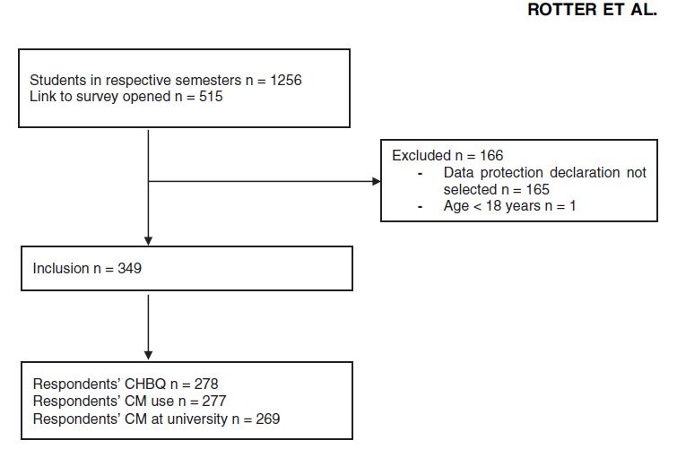
Results

Slide 24
Results
The attitude toward CM was rather neutral and more positive among females than males
Medical students favored CM university research
not agree that CM is currently taught sufficiently at the university

Slide 25
Results
The lifetime prevalence of student’s own CM use was 48.4% of respondents
Lifetime CM use of responding students was comparable between the first year and the fifth year (46.2% vs. 50.3%)

Slide 26
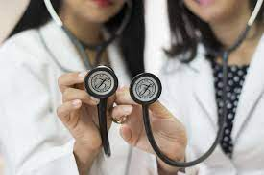
Discussion
cross-sectional study
an overview of the CM attitudes of 300 medical students
in Germany
in the first and fifth study years.

Slide 27
Discussion
The students promoted CM integration into university teaching but rated their current CM university teaching as rather insufficient.
More than one-third had studied CM on their own.

Slide 28

thanks for your attention
Thanks for your attention

